Slide 1
Ansible training
Harry Toolseram & Nitin Vig
July 2017

Slide 2
RECAP
Playbooks, Variables, Roles, Groups
Default variables:
hostvars[inventory_hostname], group_names, groups[‘groupname’]
Netconf connectivity
Get facts: junos_facts, junos_get_facts
Updating /etc/hosts & $HOME/.ssh/known_hosts

Slide 3
GITHUB SETUP
Clone an existing repo
Cloning a GIT repo:
git clone https://github.com/vignitin/SG-Ansible-Training

Slide 4
GITHUB SETUP
Setting up your own repo
Create a repo on github, but do not initialize it with README
On the local machine:
Create a local README.md in addition all the other repo files
Initialize and sync the repo
echo "# My first Ansible project" >> README.md
echo "# My first Ansible project" >> README.md
git init
git add -A
git commit -m "first commit”
git remote add origin https://github.com/vignitin/SG-Ansible-Training.git
git push -u origin master

Slide 5
GITHUB SETUP
Git commands
#What’s different between local and github
git status
#Add this file for tracking with GIT (not yet committed)
git add <filename>
#Add everything in the directory
git add . #Add all files
git add -A
#Committed, but still on the local machine.
git commit -m “<msg>”
#Push any committed changes to github
git push
#Pull all the changes from github
git pull

Slide 6
Groups
Some info on groups
There are two default groups: all and ungrouped
all contains every host.
ungrouped contains all hosts that don’t have another group aside from all.
Make groups of groups using the :children suffix.
Apply variables to groups using using :vars.

Slide 7
Agenda
YAML & Jinja2 Basics
Lab: Router base config via Ansible
Lab: VPN config via Ansible
Lab: Config verification (JSNAPy + Ansible)
Summary & References

Slide 8
YAML & JINJA2 Basics

Slide 9
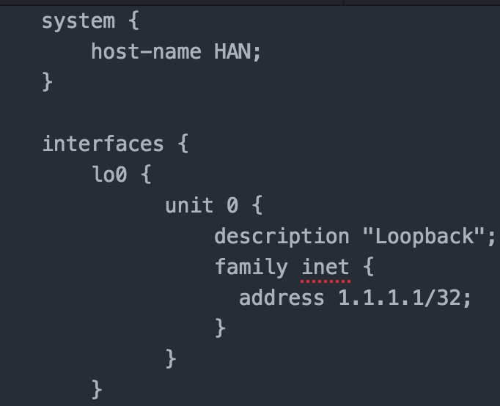
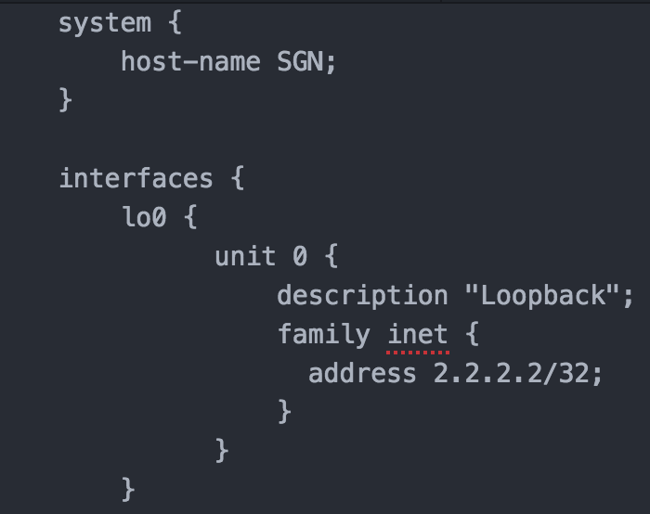
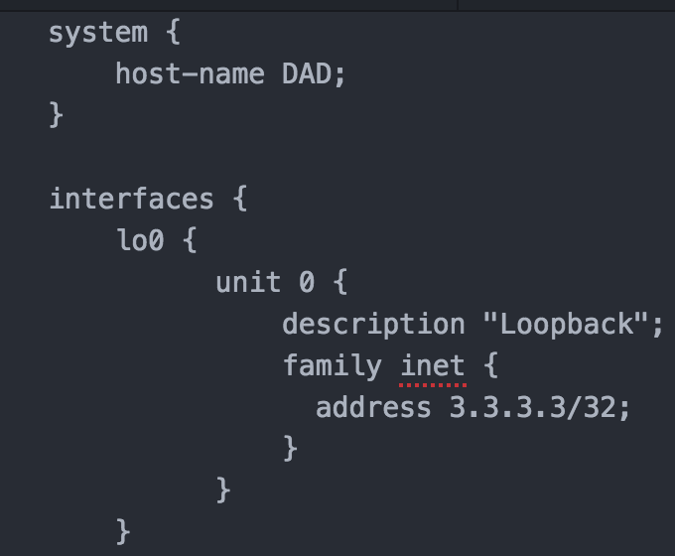
JINJA2 + YAML: Example
TYPICAL ROUTER CONFIG
Host 1: HAN
Host 2: SGN
Host 3: DAD

Slide 10
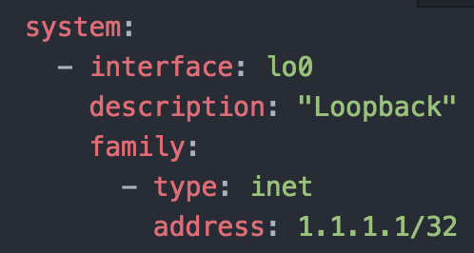
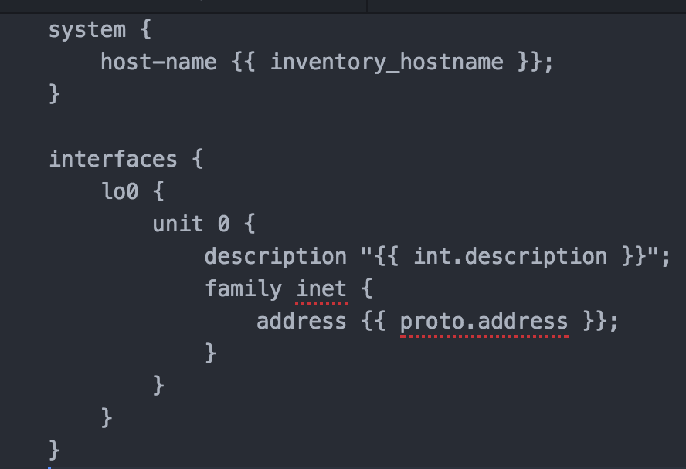
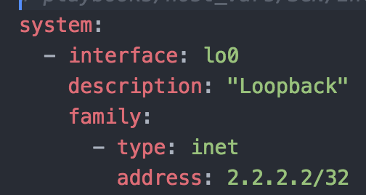
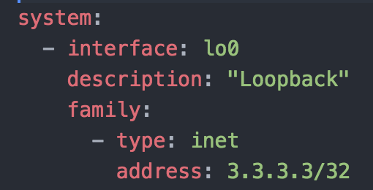
YAML
JINJA2 + YAML: Example
JINJA2
Host 1: HAN
Host 2: SGN
Host 3: DAD

Slide 11
Lab: Basic router config

Slide 12


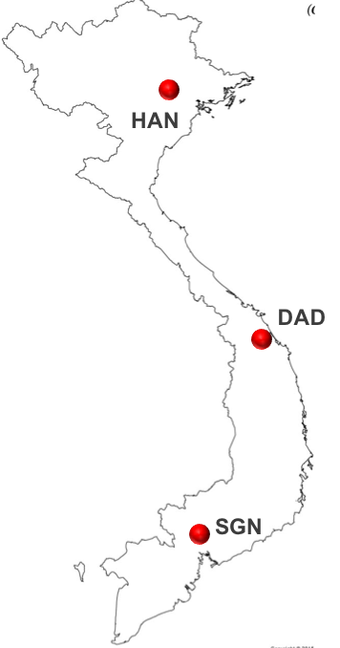

L3VPN Scenario
z
z
3 L3VPN customers across 3 cities:
Toyota: HAN, DAD
Honda: SGN, DAD
Tesla: HAN, SGN
Each customer has 5 branches in each city

Slide 13
L3VPN Scenario
z
z
Objectives:
Automated L3VPN config creation for respective routers
Config deployment to respective routers
Validation of the VPN service on the routers

Slide 14




Demo topology
ANSIBLE
Each city represented by a PE router (vMX)
Brown-field network with basic infrastructure already provisioned (IGP, MP-BGP)
All PE routers have NETCONF-SSH enabled
TOYOTA
TESLA
CORE
HAN
SGN
TESLA
HONDA
DAD
HONDA
TOYOTA

Slide 15
Demo topology
ANSIBLE
Each city represented by a PE router (vMX)
Brown-field network with basic infrastructure already provisioned (IGP, MP-BGP)
All PE routers have NETCONF-SSH enabled
TOYOTA
OOB
192.168.100.X/24
TESLA
ge-0/0/0
ge-0/0/2
CORE
172.16.1.X/24
ge-0/0/4
HAN
ge-0/0/1
SGN
TESLA
HONDA
DAD
ge-0/0/3
HONDA
TOYOTA

Slide 16
Basic router config: Hostname, Interfaces, Protocols
Basic infrastructure setup
Configure:
Hostname
Interfaces: lo0 & ge-0/0/1
Protocols: ISIS & BGP
BGP: AS 65532
172.16.1.X/24
HAN
ge-0/0/1
SGN
DAD

Slide 17
Basic router config
Steps: Build, Assemble, Push
Build config in parts
hostname & Interface
Protocols
Assemble config
Push config to router
ROLE: config_intfs
ROLE: config_protocols
ROLE: config_build
Playbook: pb.conf.commit.yaml

Slide 18
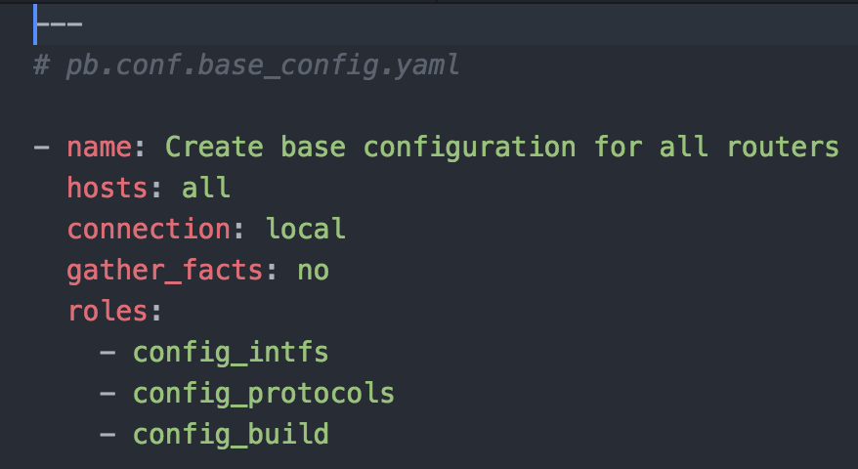
Basic router config
STEP 1: BUILD
combination
of
call
PLAYBOOKS
ROLES
=
TASKS
+
TEMPLATES
+
VARIABLES
pb.conf.base_config.yaml
config_intfs
main.yaml
main.conf.j2
derived
from
config_protocols
config_build
roles
group_vars
host_vars
playbooks/pb.conf.base_config.yaml

Slide 19
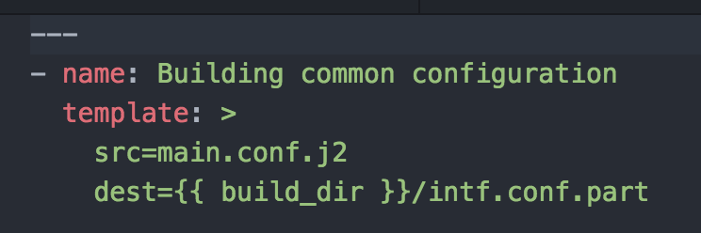
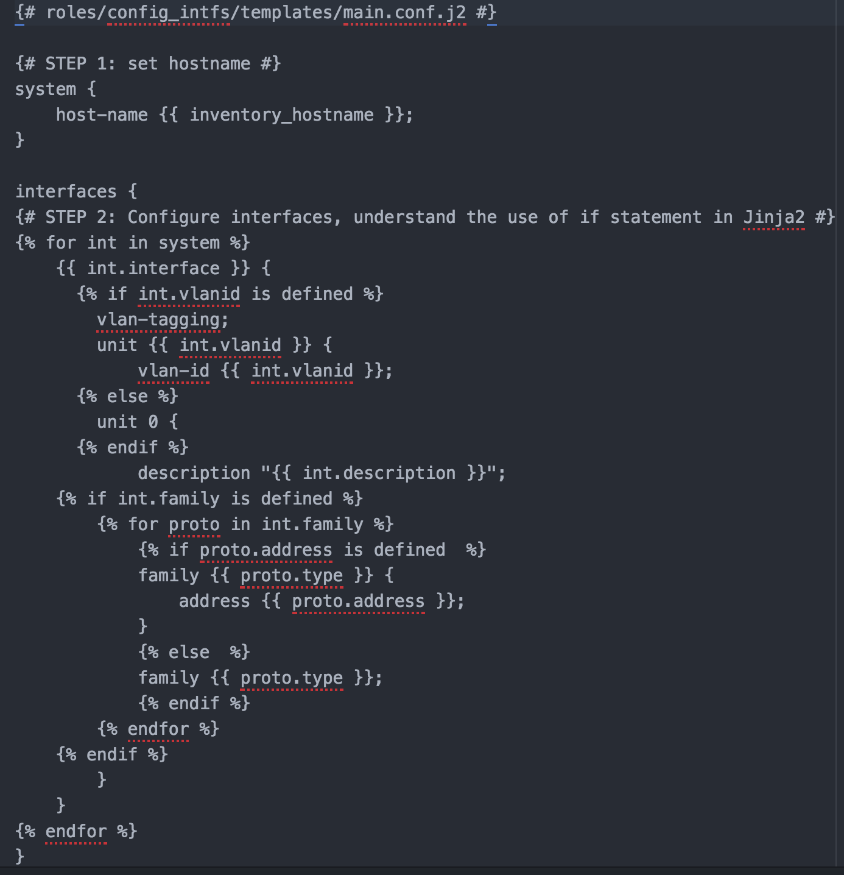
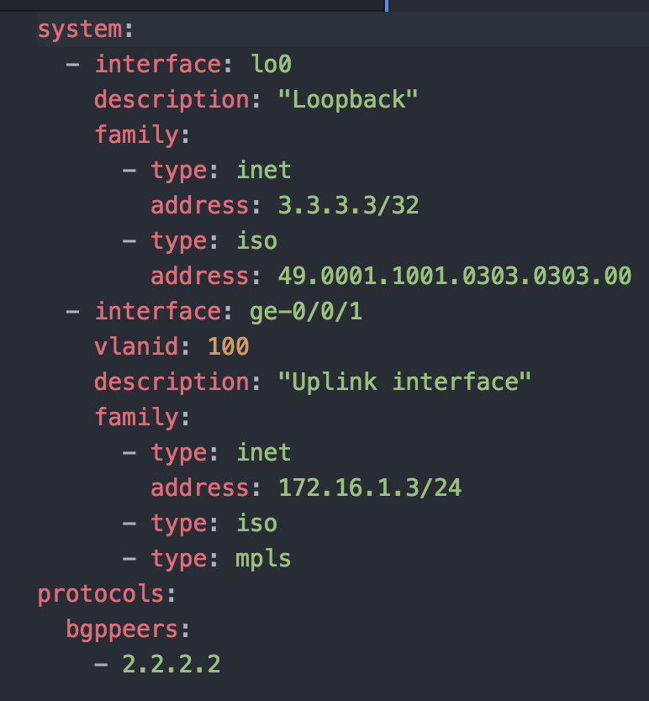
Basic router config
STEP 1: BUILD
tasks/main.yaml
Example: Hostname & Interface config
ROLE: playbooks/roles/config_intfs/
templates/main.conf.j2
host_vars/HAN/base_config.yaml

Slide 20
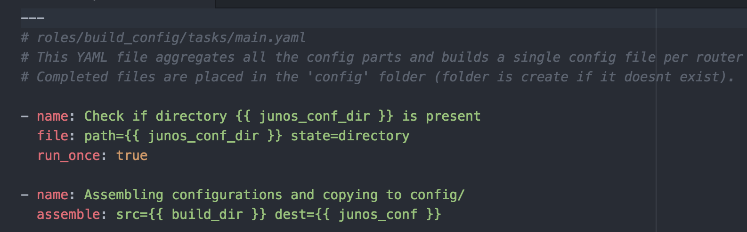
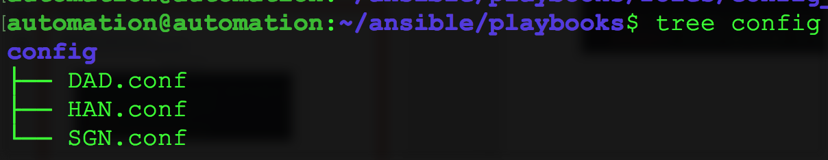
Basic router config
STEP 2: ASSEMBLE
Example: Config assembly
ROLE: playbooks/roles/config_build/
tasks/main.yaml
New config directory created with individual router configs

Slide 21
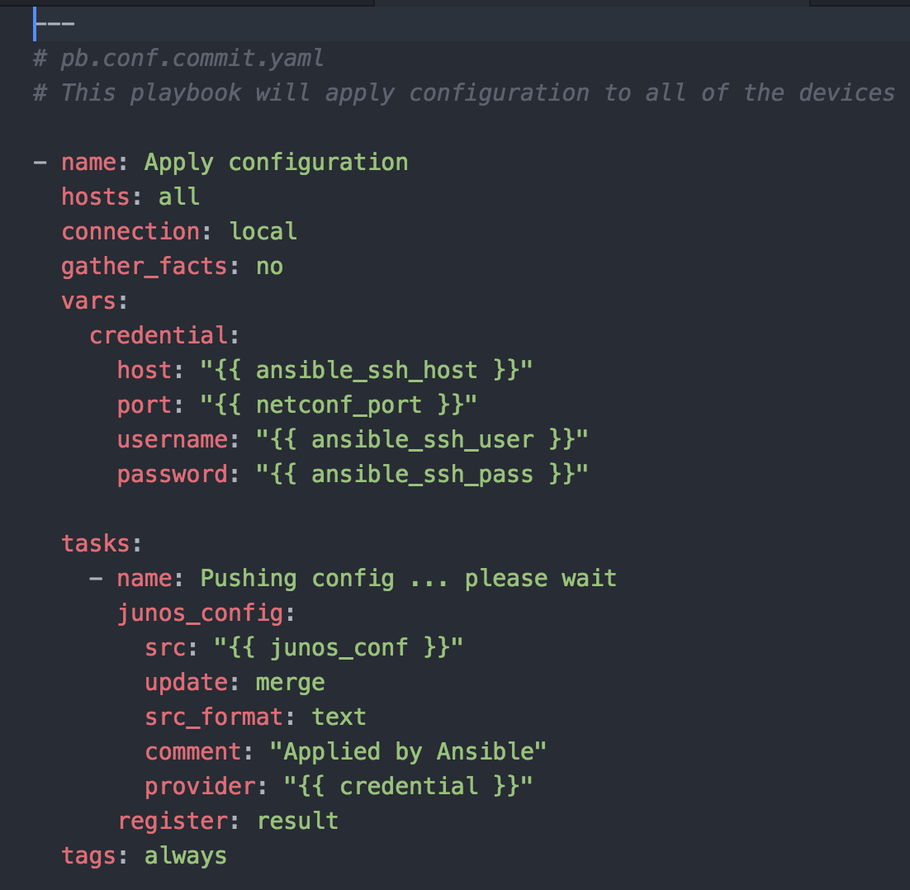
Basic router config
STEP 3: PUSH

Slide 22
Lab: VPN config

Slide 23
YAML
JINJA2 + YAML: Example
JINJA2
Host 1: HAN
Host 2: SGN
Host 3: DAD

Slide 24
Dynamic variable generation
Story so far: Each host/group-specific YAML files created by hand
Host 1: HAN
Host 2: SGN
Host 3: DAD
playbooks/host_vars/HAN/base_config.yaml
playbooks/host_vars/SGN/base_config.yaml
playbooks/host_vars/DAD/base_config.yaml

Slide 25
Dynamic variable generation
Use the concepts of JINJA + YAML to generate variables as well
Dynamic variable generation:
Capture all variables from the user in a single YAML file
Use a JINJA file to parse the user input (YAML), to generate host-specific variables (individual YAML files)

Slide 26
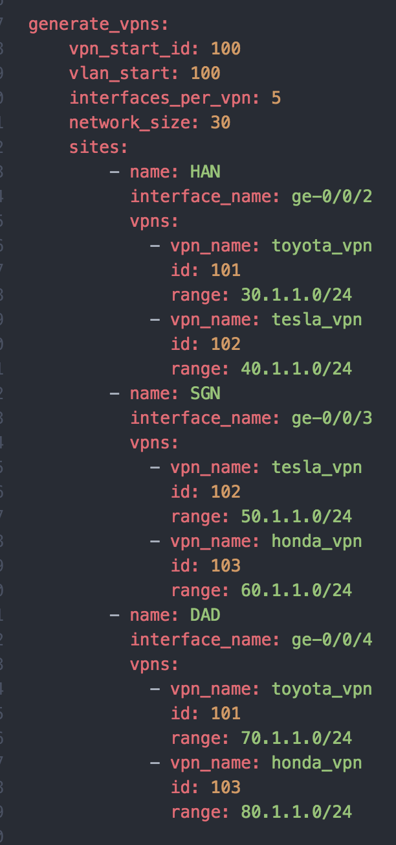
Dynamic variable generation
Sample User Input (YAML)
Use JINJA + YAML to generate variables as well
Capture user input in a single YAML file
File can be generic or be-spoke
Generic files reduce user-input and increase automation
Be-spoke files provide customization
Apply templates to user input to generate variables
Use a JINJA file to parse the user input (YAML), to generate host-specific variables (individual YAML files)

Slide 27
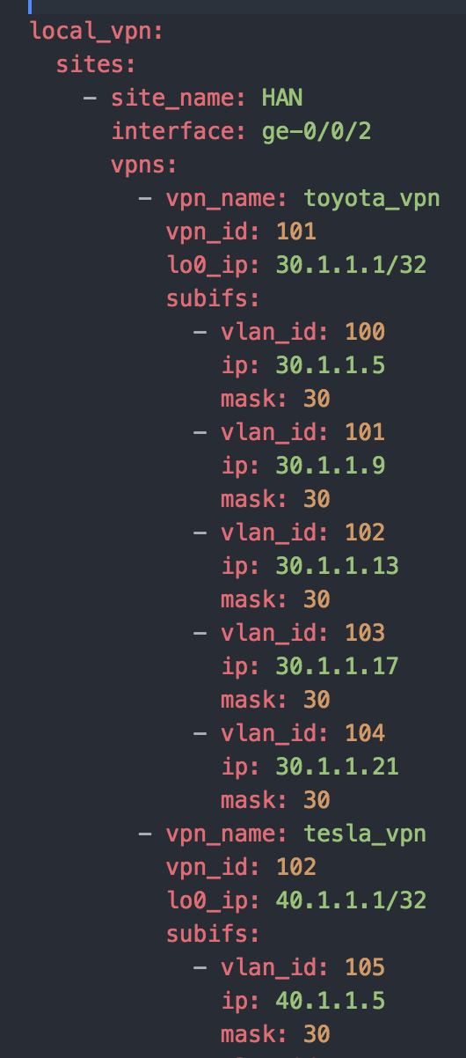
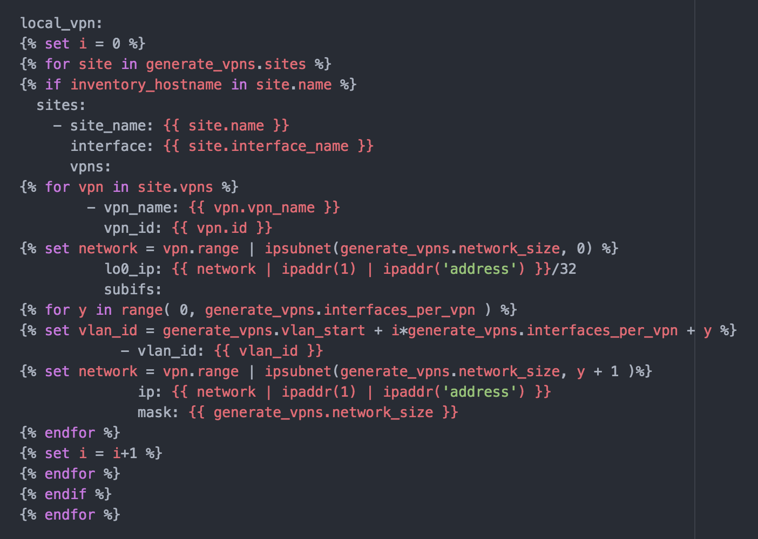
Dynamic variable generation
pb.generate.vpn.yaml
roles/generate_vpns/default/main.yaml
+
roles/generate_vpns/templates/main.conf.j2
=
host_vars/HAN/
generated_vpn_variables.yaml
User input (YAML)
Template (Jinja)
Variables (YAML)
a

Slide 28
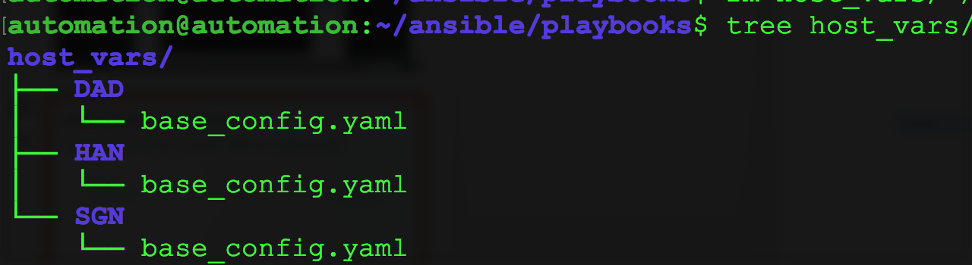
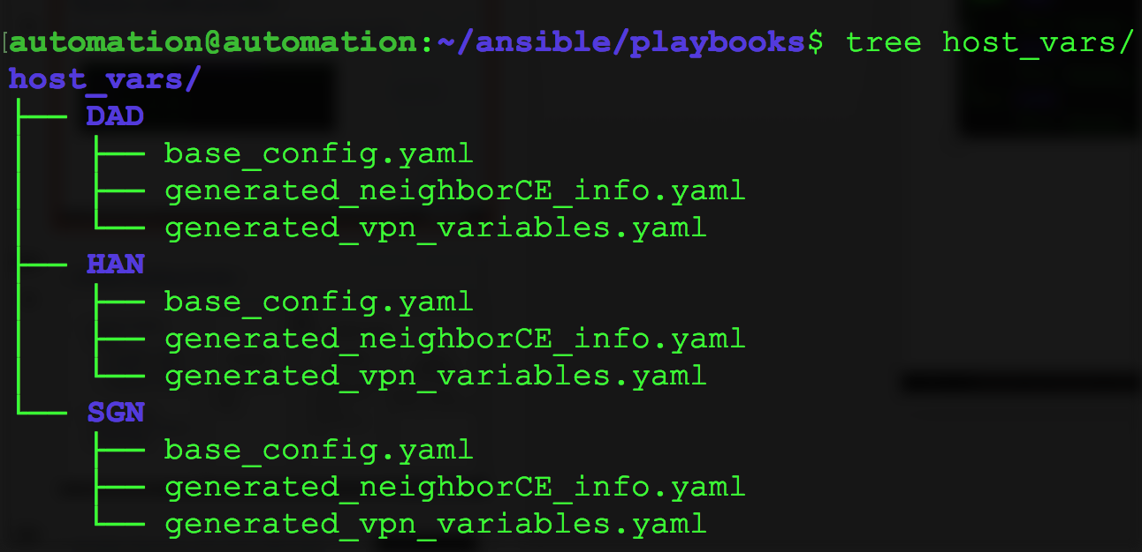
Dynamic variable generation
Before playbook
After playbook

Slide 29
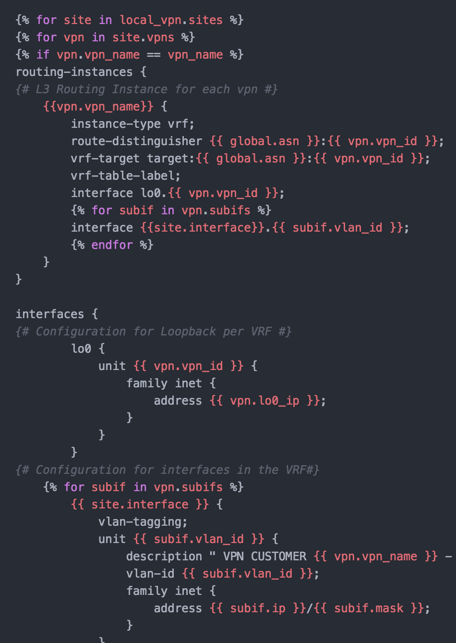
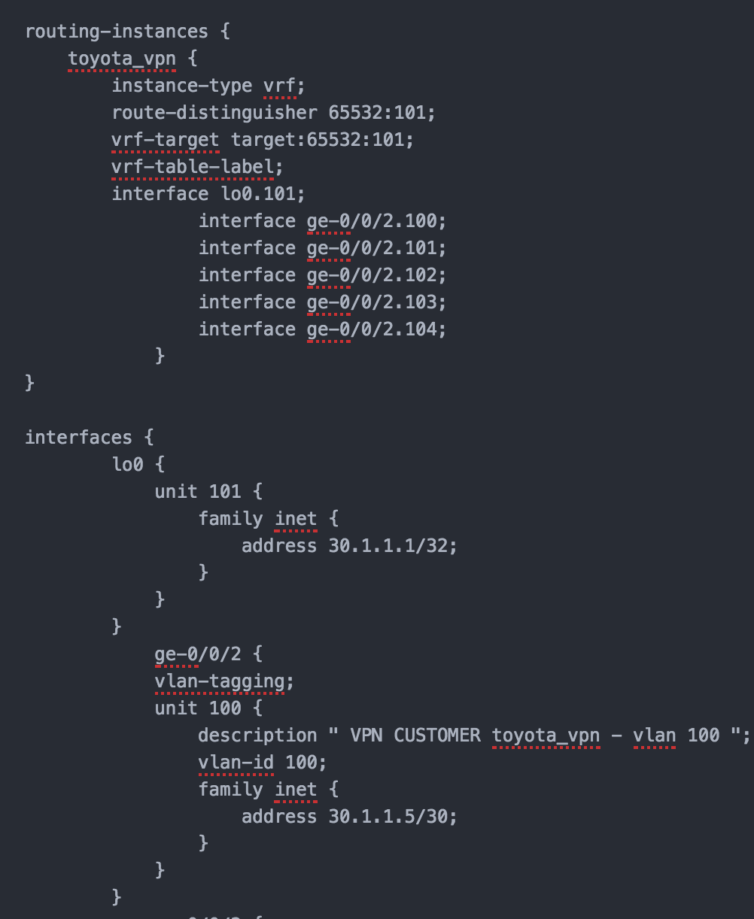
Build router config
pb.config.vpn_service.yaml
host_vars/HAN/
generated_vpn_variables.yaml
+
roles/junos_vpn/templates/main.conf.j2
=
config/HAN.conf
Variables (YAML)
Template (Jinja)
Router config
a

Slide 30
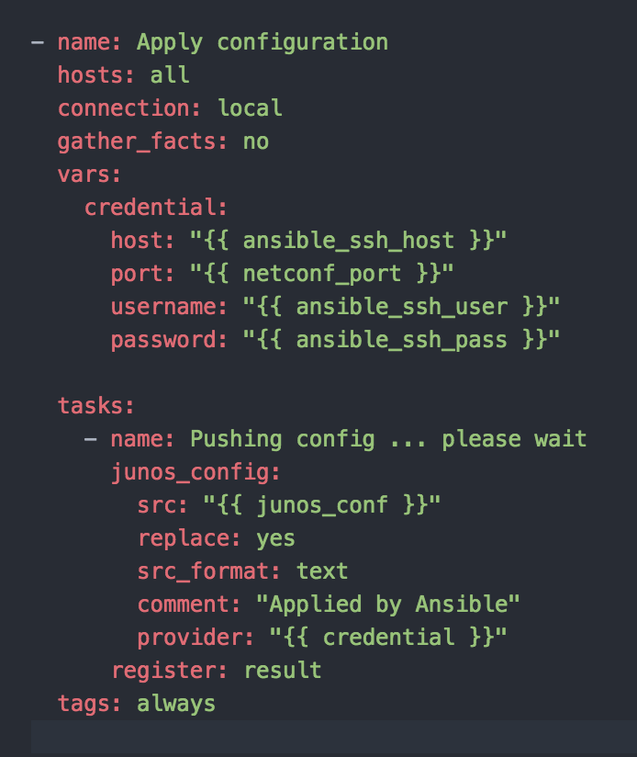
Push router config
Connect to each router via NETCONF
Push the respective config to the router
Config can be built and pushed for a single VPN customer also using tags
Config can be rolled back for devices that support this functionality

Slide 31
Lab: Config verification (JSNAPy + Ansible)

Slide 32
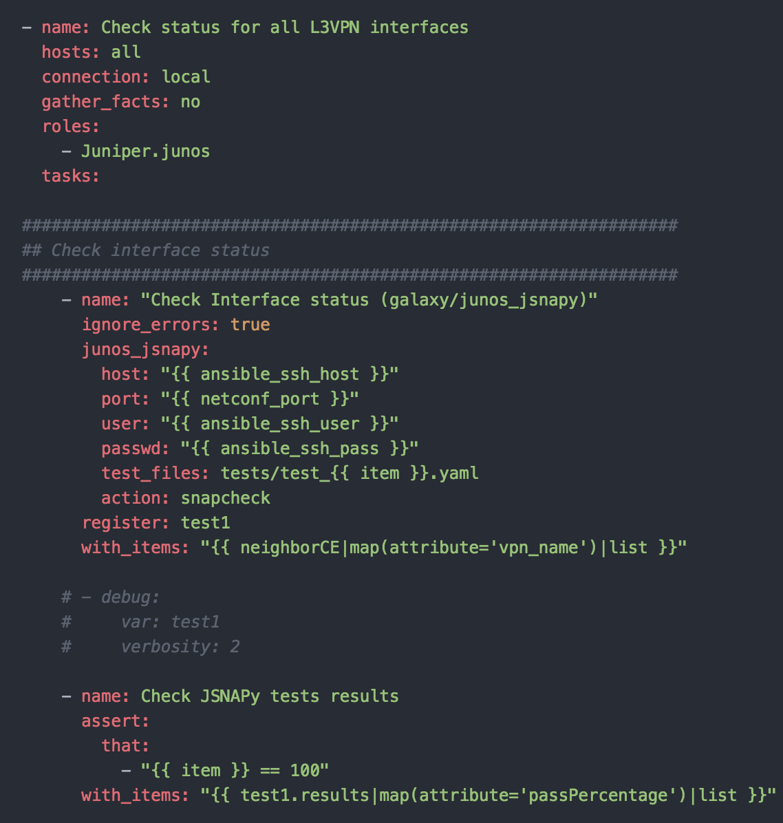
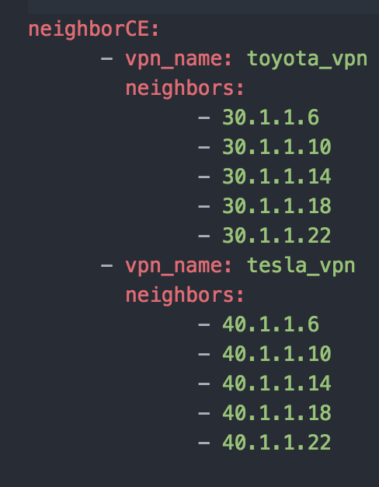
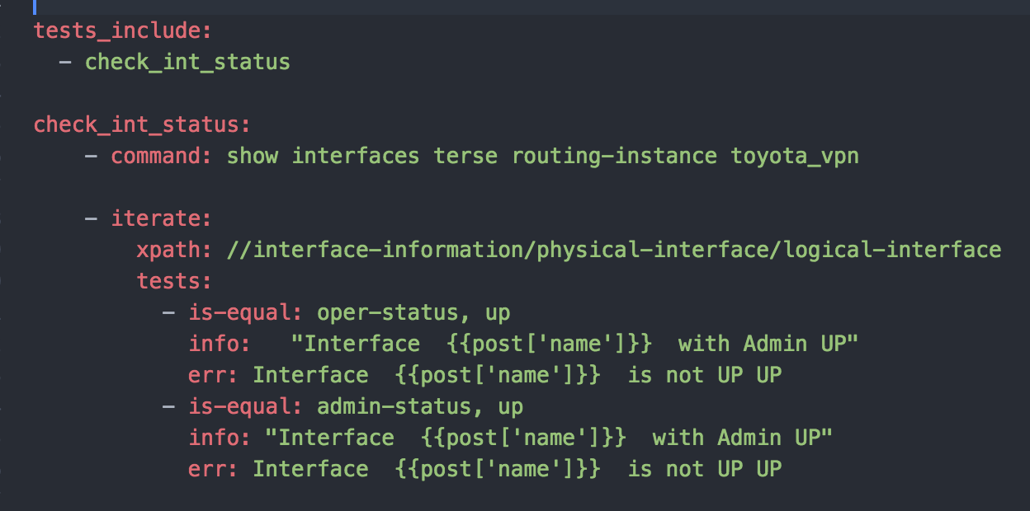
Step 5: Validate VPN service (Interface status)
+
host_vars/HAN/
generated_neighborCE_info.yaml
+
tests/test_toyota_vpn.yaml
pb.check.ifstatus.yaml
Playbook (YAML)
Variables (YAML)
Test file

Slide 33
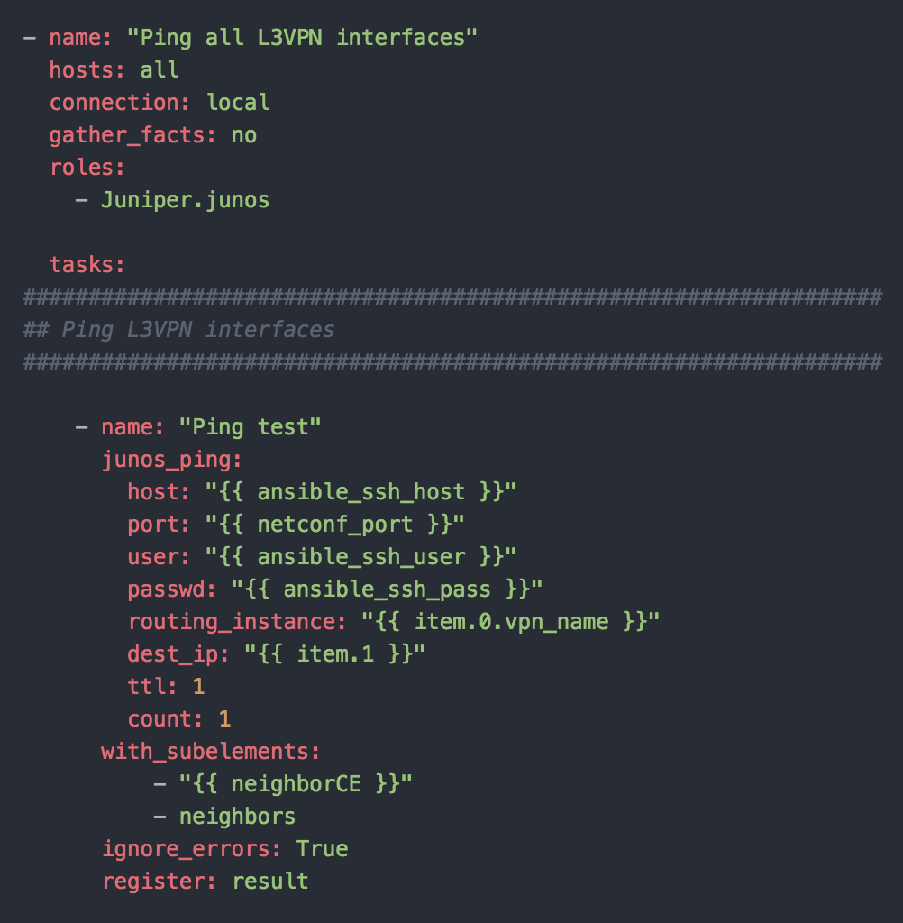
Step 5: Validate VPN service (Ping CE)
pb.check.ping.yaml
+
host_vars/HAN/generated_neighborCE_info.yaml
Playbook (YAML)
Variables (YAML)

Slide 34
Github setup

Slide 35
Summary & References

Slide 36
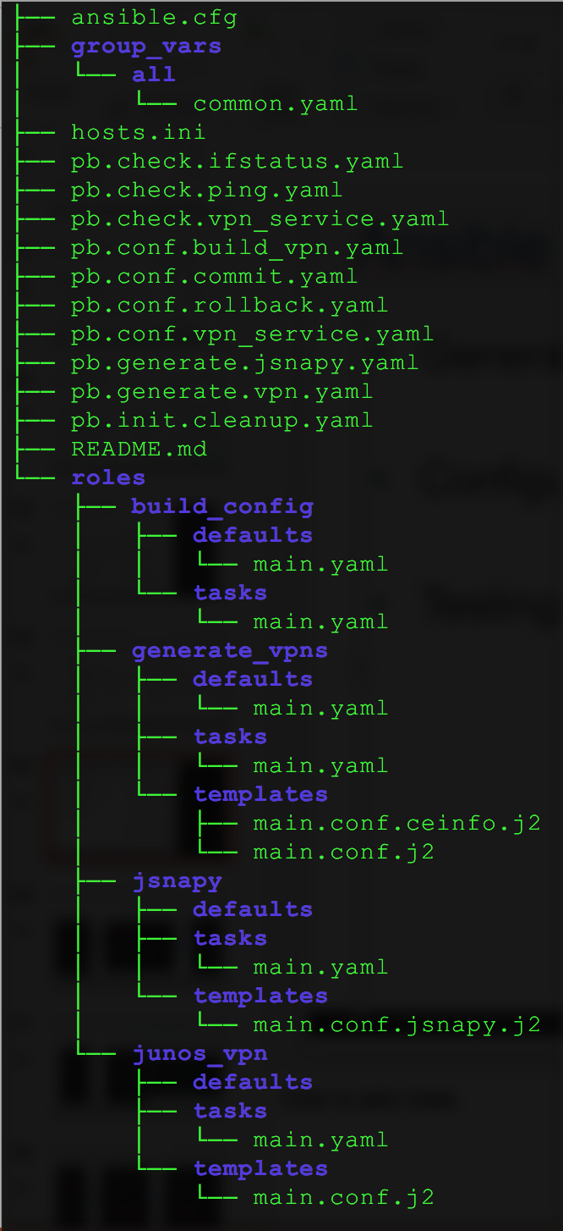
Ansible directory structure: Playbooks
Sample User Input (YAML)
Testing PBs
Generate PBs: Generate variables for configuration and testing
pb.generate.vpn.yaml
pb.generate.jsnapy.yaml
Configuration PBs: Generate and push configs
pb.config.vpn_service.yaml
pb.init.cleanup.yaml
pb.config.build_vpn.yaml
pb.config.commit.yaml
Testing PBs: Test the service
pb.check.vpn_service.yaml
pb.check.ifstatus.yaml
pb.check.ping.yaml
Configuration PBs
Generate PBs
Initial PB
Roles

Slide 37
Ansible directory structure: Roles
Sample User Input (YAML)
Testing PBs
Roles:
generate_vpns
Used by Generate PBs
junos_vpn
Used by Configuration PBs
build_config
Used by Configuration PBs
jsnapy
Used by Testing PBs
Configuration PBs
Generate PBs
Initial PB
Roles

Slide 38
Lab resources
Setup documents, VBox images, Playbooks, Training PPTs
Dropbox (VBox images, setup doc, Training PPTs):
https://www.dropbox.com/sh/jb8niq3b6suvbcg/AAC3cWY_4mGsCWrrF-qY0wtoa?dl=0
Github (playbooks):
https://github.com/vignitin/SG-Ansible-Training

Slide 39
Juniper modules for Ansible
Core:
Details: http://docs.ansible.com/ansible/list_of_network_modules.html#junos
Install (along with Ansible): pip install ansible
Galaxy:
Details: https://galaxy.ansible.com/Juniper/junos/
Install: sudo ansible-galaxy install Juniper.junos
Github:
Details: https://github.com/Juniper/ansible-junos-stdlib
Install: git clone https://github.com/Juniper/ansible-junos-stdlib.git

Slide 40
Interesting Ansible projects
Configure and test and EVPN/VXLAN fabric using Ansible:
https://github.com/JNPRAutomate/ansible-junos-evpn-vxlan
Using Openconfig & Ansible to configure network devices:
https://github.com/ksator/openconfig-demo-with-juniper-devices
JUNOS Automation with Chatops:
https://github.com/ksator/junos-automation-with-chatops

Slide 41
Network telemetry
Open Source Telemetry Collector for Telemetry, Netconf and Events
https://github.com/Juniper/open-nti
Fluentd plugin for Juniper Telemetry Streaming:
https://github.com/JNPRAutomate/fluent-plugin-juniper-telemetry

Slide 42
harryt@juniper.net
nitinvig@juniper.net

Slide 43
Step 2: Generate variables (Config & testing)
Config Variables
Testing Variables & files
generate_vpn_variables.yaml
generate_neighborCE_info.yaml
test_<VPNname>.yaml

